Slide 1


CYBR644 – Cyber Practitioner Lab
Spring 2024
University of Maryland, Baltimore County
Michael Hennick

Slide 2
Overview of the course
Week 01 – Introduction, Ethical Hacking Basics, Ethics, Law
Week 02 – Technical Foundations of Hacking
Week 03 – Reconnaissance, Social Media
Week 04 – Scanning and Probing
Week 05 – Vulnerability Identification
Week 06 – Exploiting Weaknesses
Week 07 – Class Presentations / Review for Exam
Week 08 – Spring Break
Week 09 – Midterm Exam
Week 10 – Privilege Escalation, Maintaining Access
Week 11 – Malware, Covering your Tracks
Week 12 – The Web
Week 13 – Wireless and Mobile Security
Week 14 – Physical Security, Social Engineering, and Security Policies
Week 15 – Class Presentations / Review for Exam
Week 16 – Final Exam

Slide 3

Review
What is Reconnaissance
Performing preliminary research on target
Low Tech Recon
Visiting/Breaking In
Dumpster Diving
Social Engineering
Tech Recon
Social Engineering
Registration Info
OSINT
Shodan
Bing
Google
Google Hacking

Slide 4

Review
What is Social Media?
Social Networking Sites
Communications/Email
Collaboration/Authoring
Multimedia
Review
Social Media Data Mining
The Harvester
Spiderfoot
Recon-ng

Slide 5
News
https://medium.freecodecamp.org/discovering-the-hidden-mine-of-credentials-and-sensitive-information-8e5ccfef2724

Slide 6
Where are we?
Phase 1 provided us with information on our target
Network Ranges
Key systems of interest
Technologies Used
Insight into potential attack vectors
Insight into potential passwords
….Now that we’ve walked around the neighborhood and checked out the houses and driveways, lets jiggle some door knobs and push on some windows…..

Slide 7
What is Scanning/probing?
Automated method to poke at a target system
- Scan for active systems within a network range
- Probe the active systems for open ports, software in use, and versions
Also known as OS Fingerprinting, Enumeration, Footprinting

Slide 8
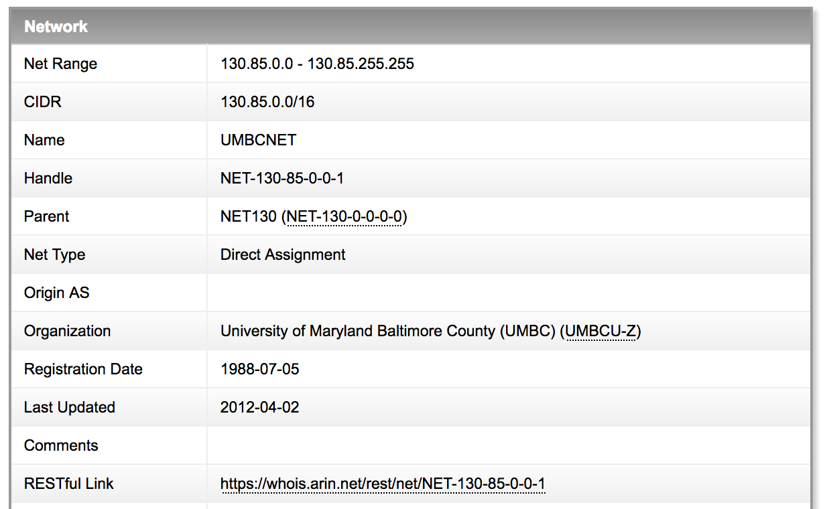
Scanning
Find all systems online and available to find vulnerabilities on
Take the network range from the target and perform a “ping sweep”
Examples:
Apple: 17.0.0.0/8 – 16,777,216 addresses
UMBC: 130.85.0.0/16 – 65,534 addresses
Howard Community College: 204.126.132.0/23 – 512 addresses

Slide 9
Scanning
Use the ping command to determine if the machine is active.
Ping requests could be disabled on the target system.
Perform a ping sweep to ping multiple machines at the same time
65,535 TCP and UDP ports available.
Hackers usually scan the first 1024 ports.
TCP is easier to scan than UDP.

Slide 10
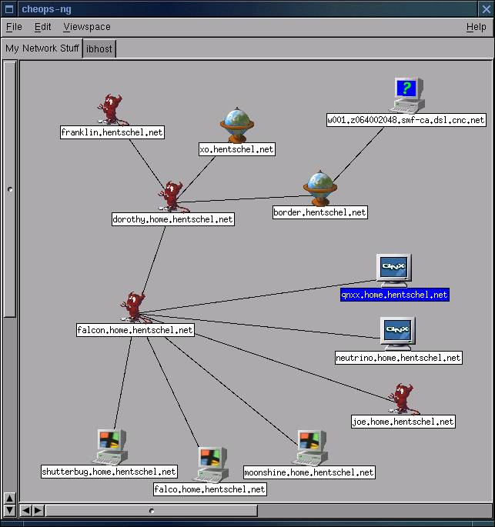

Scanning
Do we want to use “Ping” for 16,777,216 addresses?
Do we want to use “Ping” for 512 addresses?
What about using “Traceroute”?
Autoscan/Cheops
Graphical tool to perform host discovery
ZenMap
Graphical version of nmap
Hping/nmap
Command line tool to perform host discovery
Custom packet crafting
ICMP Pings
TCP/UDP packets

Slide 11
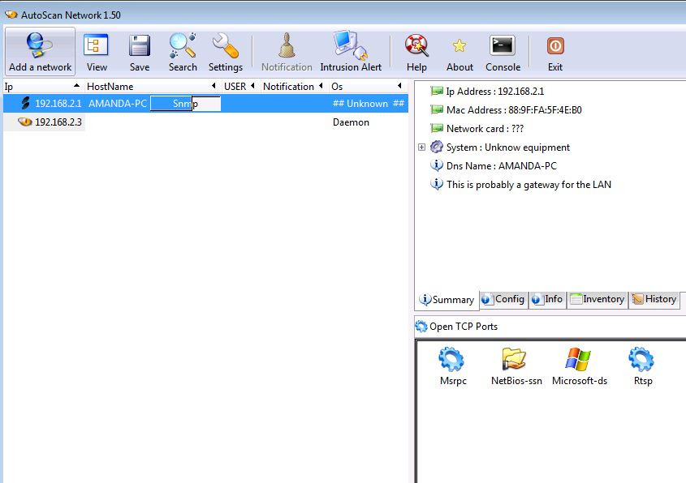
Autoscan

Slide 12
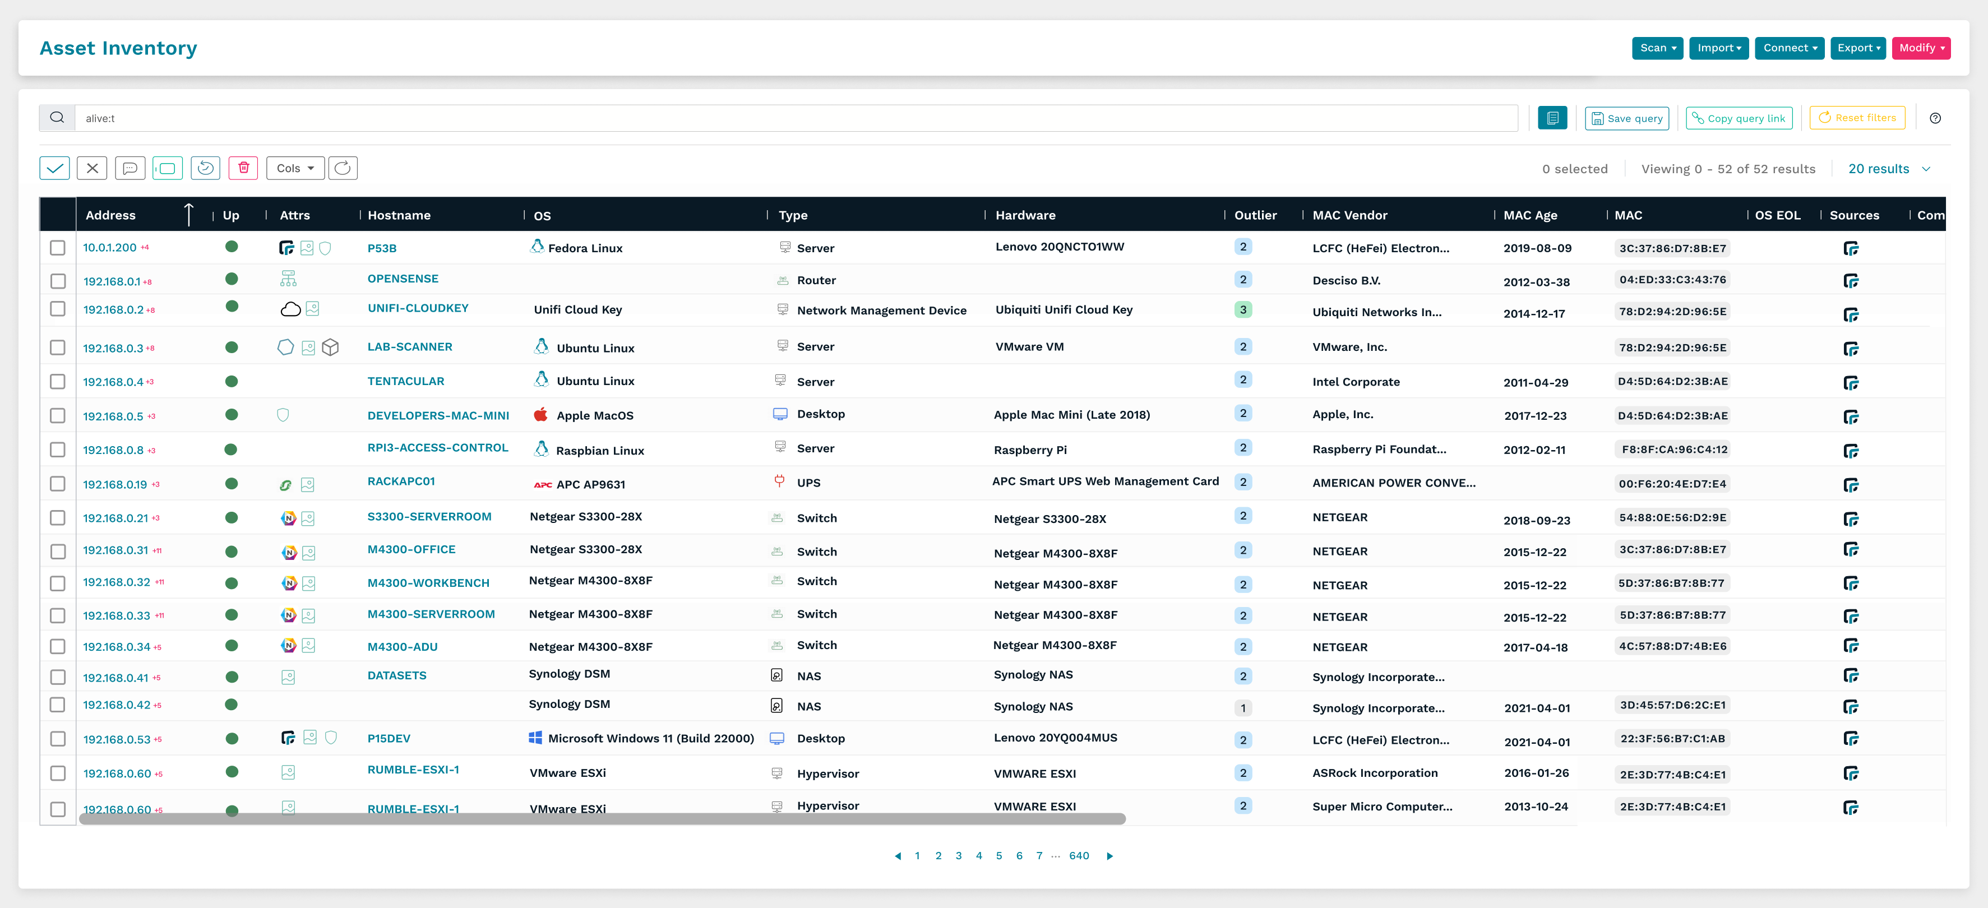
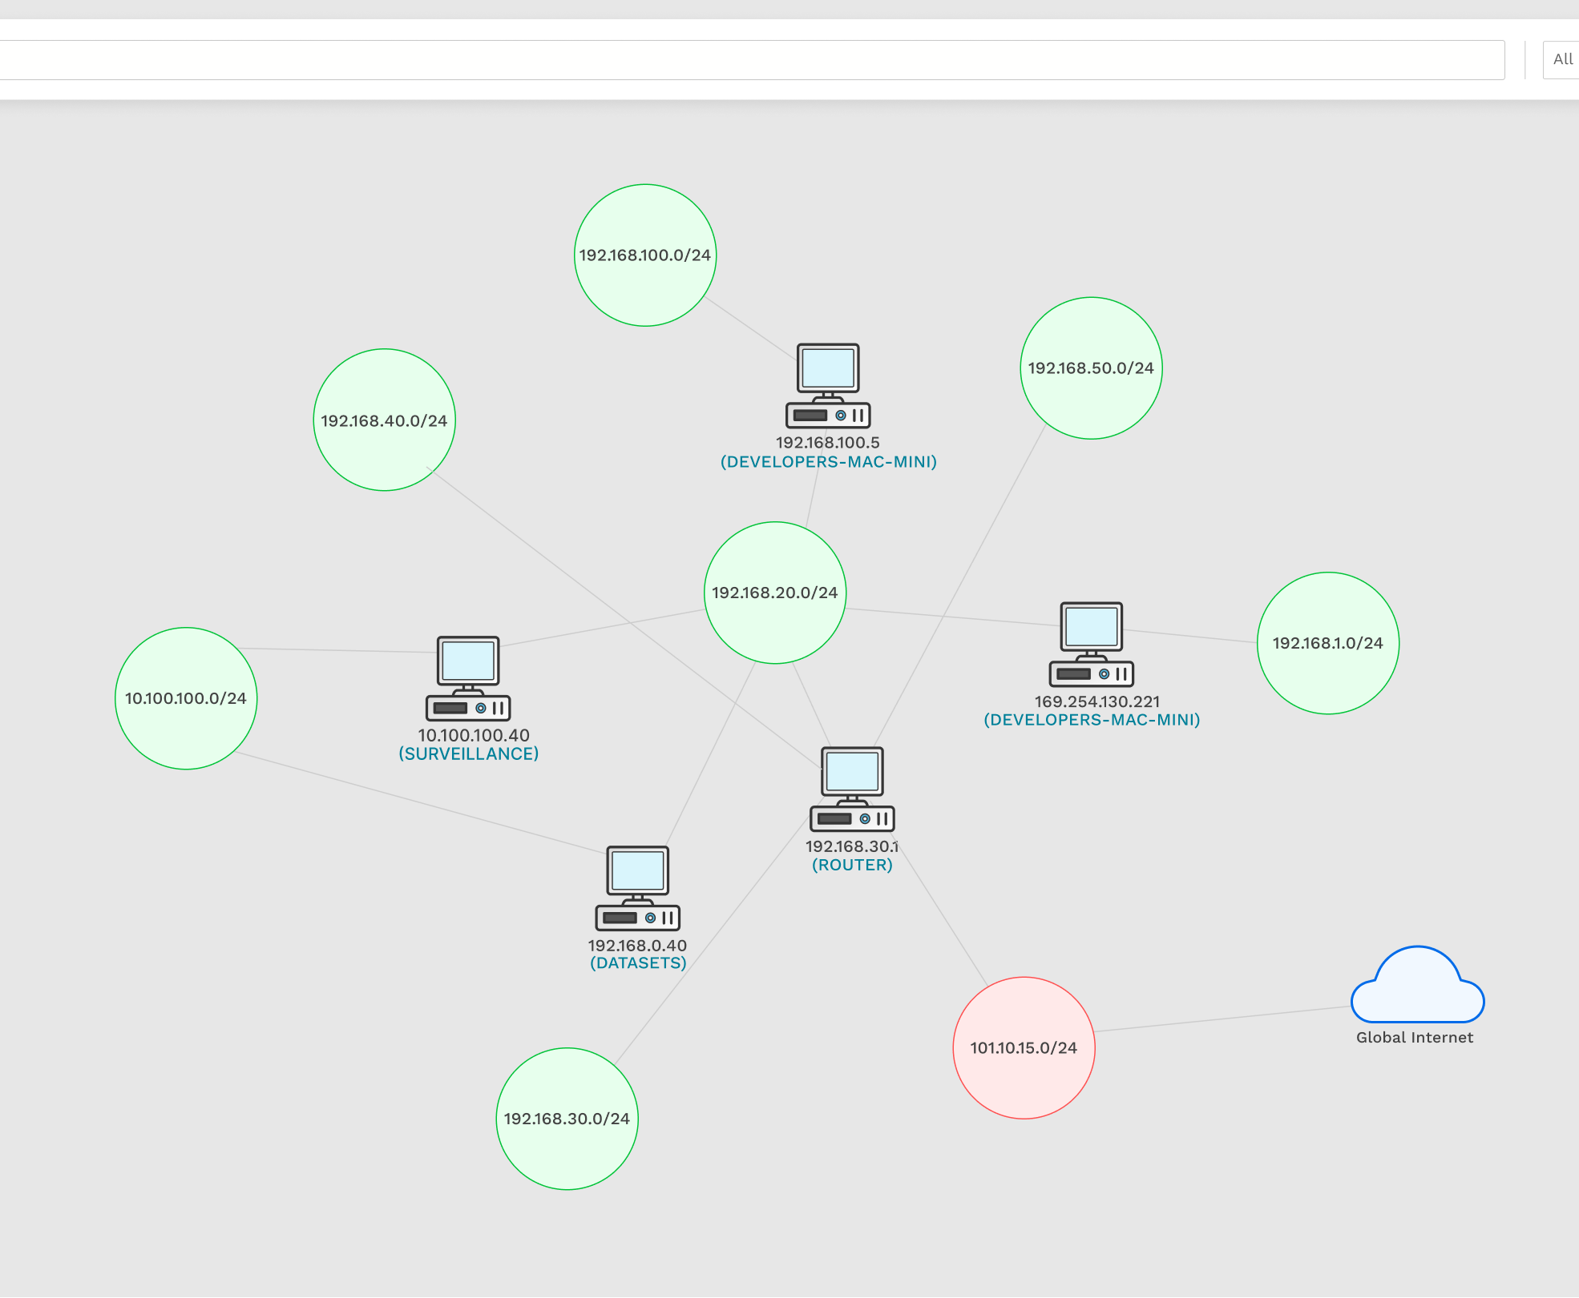
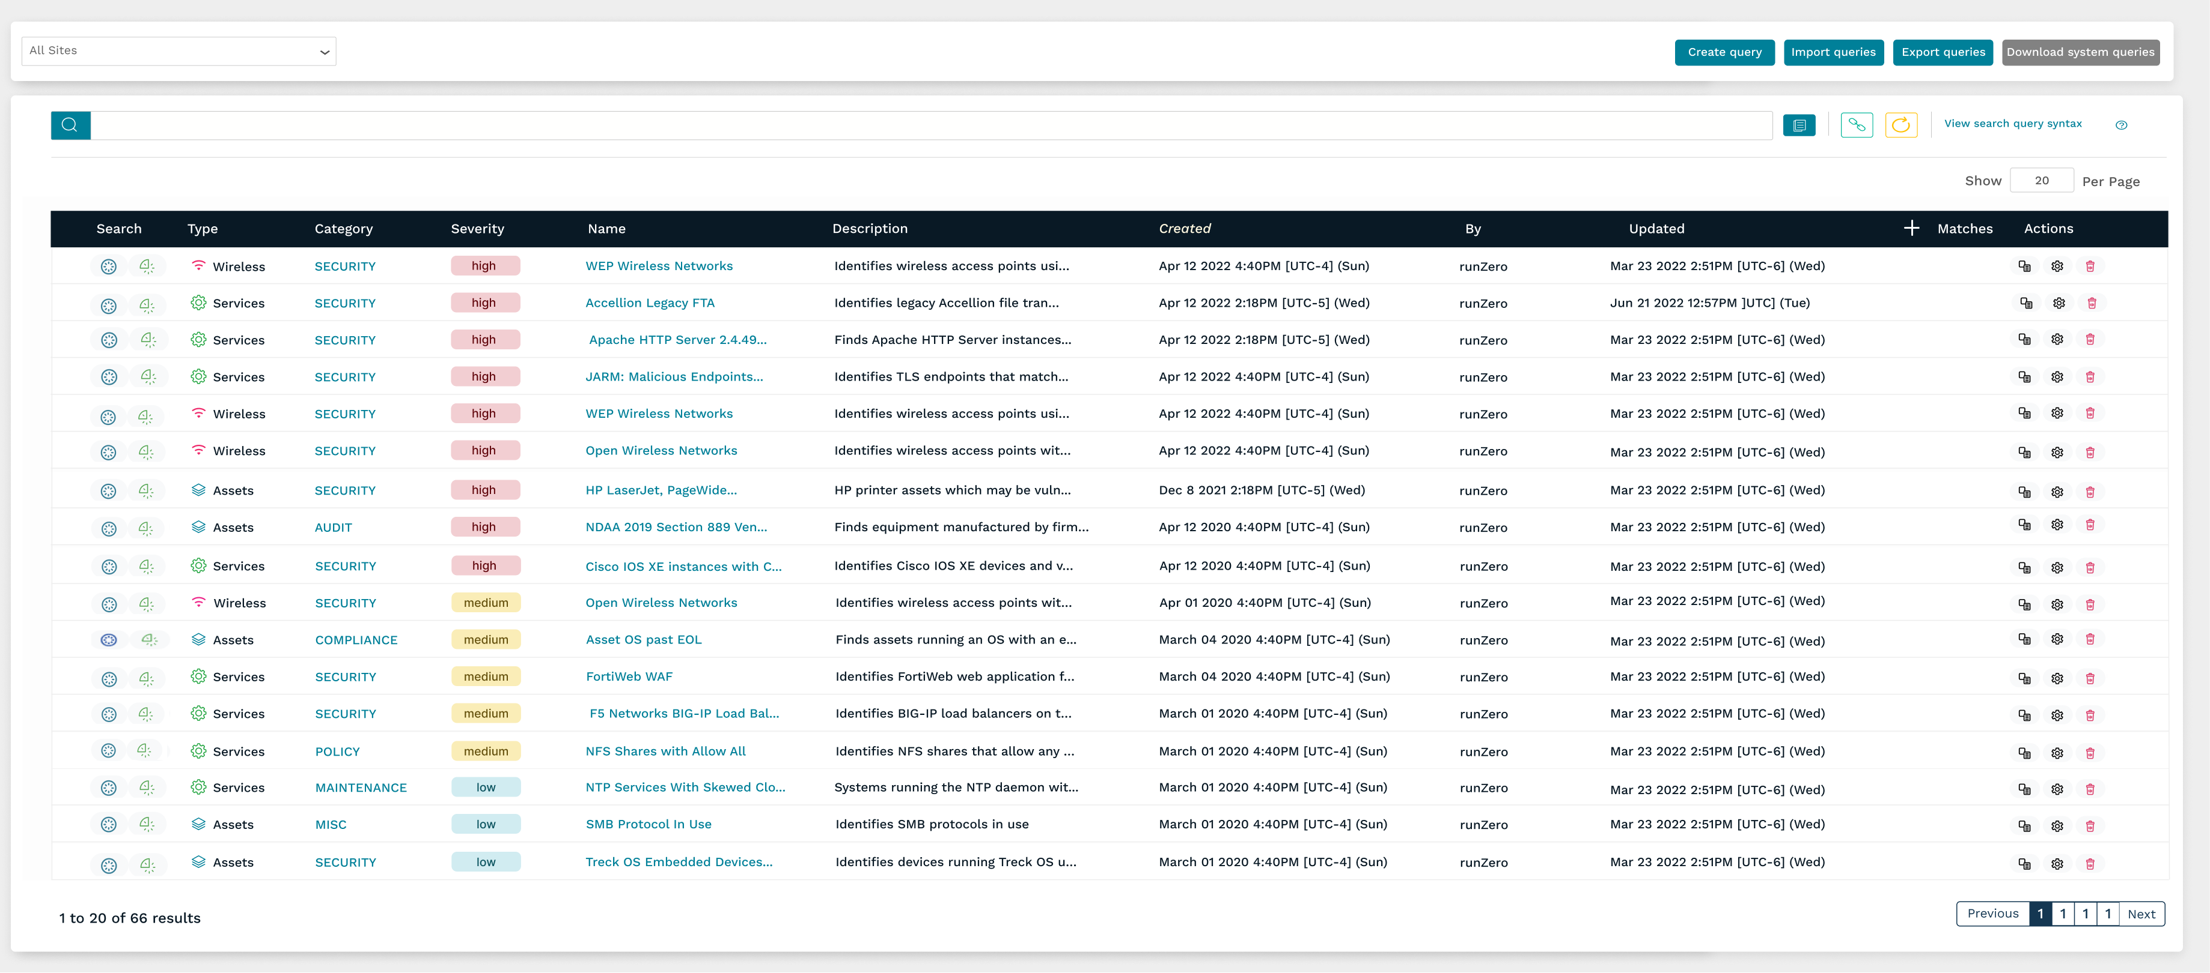
Rumble / RunZero
www.rumble.run
www.runzero.com

Slide 13
TCP Communications
TCP three-way handshake process
Client sends a SYN packet
Server responds with SYN/ACK
Client sends an ACK packet
TCP four-step shutdown process
Client sends FIN/ACK packet
Server sends ACK packet
Server sends FIN/ACK packet
Client sends ACK packet

Slide 14
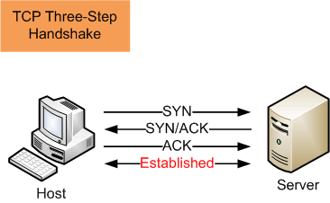
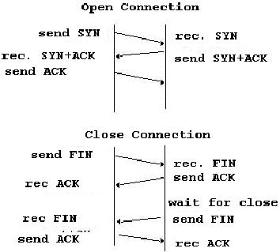
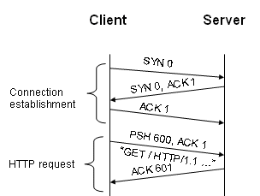
TCP/IP PRIMER

Slide 15

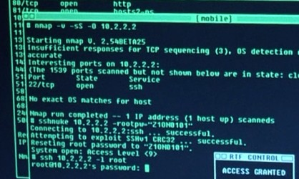
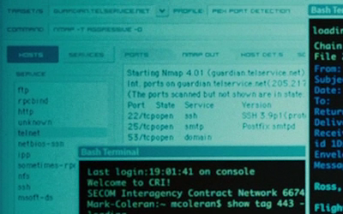

NMAP

Slide 16

NMAP
Nmap ("Network Mapper") is a free and open source utility for network exploration or security auditing.
Many systems and network administrators also find it useful for tasks such as network inventory, managing service upgrade schedules, and monitoring host or service uptime.
Nmap uses raw IP packets in novel ways to determine what hosts are available on the network, what services (application name and version) those hosts are offering, what operating systems (and OS versions) they are running, what type of packet filters/firewalls are in use, and dozens of other characteristics.
It was designed to rapidly scan large networks, but works fine against single hosts.

Slide 17
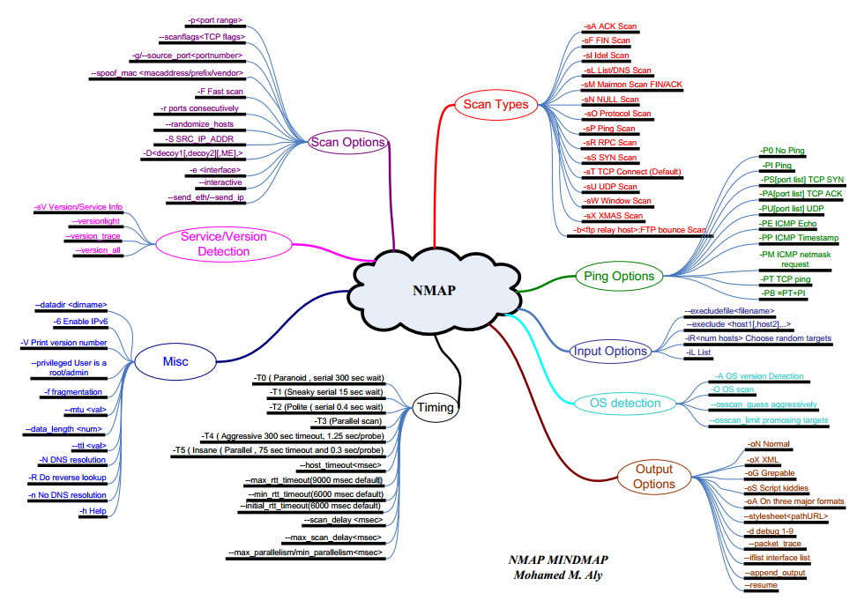
NMAP

Slide 18
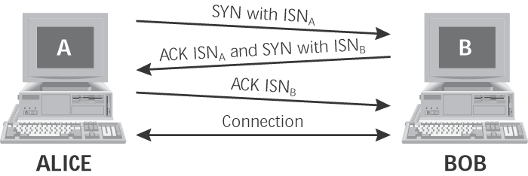
NMAP
TCP Connect (-sT)
Attempts to completes 3-way handshake with each scanned port
Sends SYN and waits for ACK before sending ACK
Tears down connection using FIN packets
If target port is closed, sender will received either no response, a RESET packet , or an ICMP Port Unreachable packet.
Not stealthy

Slide 19
NMAP
TCP SYN (-sS)
Only sends the initial SYN and waits for ACK to detect open port.
SYN scans stop two-thirds of the way through the 3-way handshake
Attacker sends a RESET after receiving a SYN-ACK response
A true connection is never established
If target port is closed, destination will send a RESET or nothing.
Faster and stealthier than Connect scans
SYN flood may cause accidental denial-of-service attack if target is slow

Slide 20
NMAP
TCP FIN (-sF)
Sends a TCP FIN to each port. A RESET indicates that the port is closed, while no response may mean that the port is open
TCP Xmas Tree (-sX)
Sends a packet with FIN, URG, and PUSH code bits set. A RESET indicates that the port is closed, while no response may mean that the port is open
Null (-sN)
Sends packets with no code bits set. A RESET indicates that the port is closed, while no response may mean that the port is open.

Slide 21
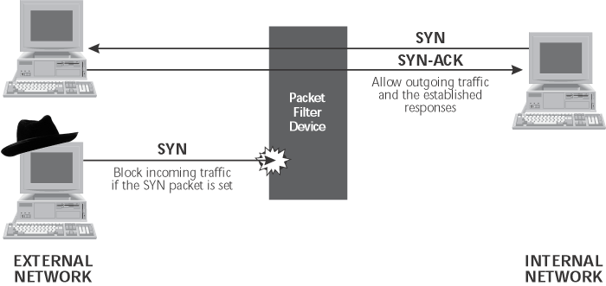
NMAP
TCP ACK (-sA)
Sends a packet with the ACK code bit set to each target port.
Allows attacker to get past some packet filtering devices

Slide 22
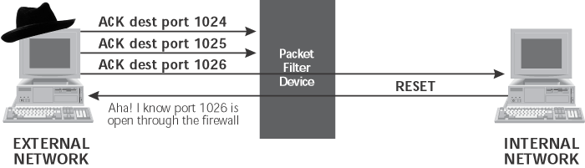
NMAP
TCP ACK (-sA)
Allows attacker to determine what kind of established connections a firewall or router will allow into a network by determining which ports through a firewall allow established connection responses
If no response or an ICMP Port Unreachable message is returned, Nmap will label the target port as “filtered”, meaning that a packet filter is blocking the response

Slide 23
NMAP
UDP Scanning (-U)
Sends a UDP packet to target ports to determine if a UDP service is listening
If the target system returns an ICMP Port Unreachable message, the target port is closed. Otherwise, the target port is assumed to be open.
Unreliable since there may be false positives
Client program of discovered open port is used to verify service
Ping (-sP or -sn)
Sends ICMP echo request packets to every machine on the target network, allowing for locating live hosts. This isn’t port scanning; it’s network mapping.
Can use TCP packets instead of ICMP to conduct Ping sweep

Slide 24
NMAP
Version Detection (-sV)
Used in conjunction with your scan types to identify the versioning of a service running on an open port
Output (-oN, -oM)
Output into human readable file: -oN
Output into machine readable file: -oM
Can be scripted to run and output results to be read into other tools

Slide 25
NMAP Timing
-T option
Paranoid (-T0)
Send one packet every 5 minutes
Sneaky (-T1)
Send one packet every 15 seconds
Polite (-T2)
Send one packet every 0.4 seconds
Normal (-T3)
Send packets as quickly as possible without missing target ports
Aggressive (-T4)
wait no more than 1.25 seconds for any response
Insane (-T5)
wait no more than 0.3 seconds for any response
Prone to traffic loss

Slide 26
NMAP Examples
Perform a simple Ping scan against the full class C network 192.168.0.0
nmap –sn 192.168.0.0/24
Perform a paranoid TCP Connect scan on all systems within the IP range of 192.168.0.1 through 192.168.0.100
nmap –T0 -sT 192.168.0.1-100
Perform a TCP SYN scan on all systems within the IP range of 192.168.0.1 through 192.168.0.100 on ports 23 and 80
nmap –sS –p 23,80 192.168.0.1-100
Perform an aggressive TCP Connect scan on a specific system (192.168.0.10) on port 80 and perform Version detection
nmap –T4 –sT –sV –p 80 192.168.0.10

Slide 27

Break

Slide 28
OS Fingerprinting
Passive fingerprinting:
Sniffing the packets and examining them to determine the OS
IP TTL value
TCP Windows size
IP DF option
IP Type of Service (TOC) option
P0f – Linux-based passive fingerprinting tool
Active fingerprinting:
Sending malformed packets to the target
More accurate than passive but can be detected by IDS

Slide 29
OS Fingerprinting Cont.
Methods for active fingerprinting:
FIN probe
Bogus flag probe
Initial Sequence Number (ISN) sampling
IPID sampling
TCP initial window
ACK value
Type of service
TPC options
Fragmentation handling

Slide 30
Fingerprinting Services
Identify the services running on specific ports
Banner grabbing: provides information on the type and version of the software running:
Telnet
HTTPrint
Netcat
FTP
Port scanners

Slide 31
Defenses
Network Scanning
Block incoming ICMP messages at the gateway
Filter ICMP “Time Exceeded” messages leaving your network (render’s traceroute useless)
Port Scanning
Unix systems
remove all unneeded services in /etc/inetd.conf
Remove unneeded services in /etc/rc*.d
Windows systems
uninstall unneeded services or shut them off in the services control panel
Scan your own systems before the attackers do
Use stateful packet filter or proxy-based firewall
blocks ACK scans
Blocks FTP data source port scans

Slide 32


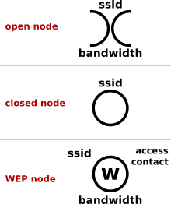
What about wireless?
War Driving
Based on War-Dialing, but for finding access points
War Chalking

Slide 33
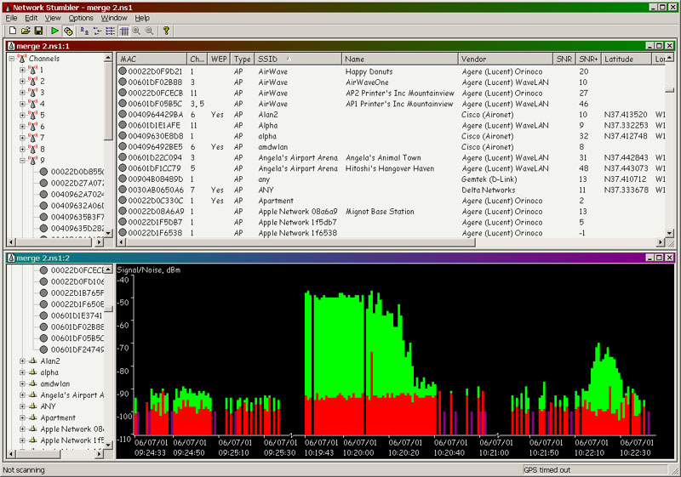
WiFi Scanning
Netstumbler

Slide 34
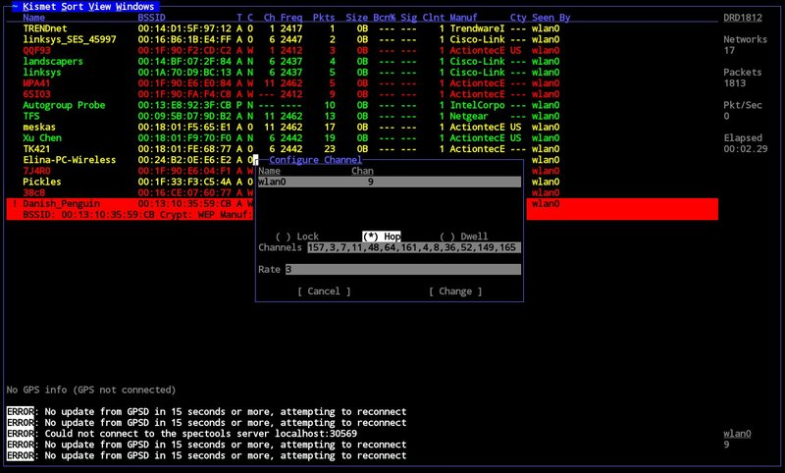
WiFi Scanning
Kismet

Slide 35
WiFi Scanning
Why scan, when we can search what previous people scanned – http://www.wigle.net

Slide 36
Perspectives
Attacker Perspective
1. Identify systems that are part of the target’s network
2. Enumerate the services running on these systems to find potential attack vectors
3. Identify the version of applications running on the ports/ providing the services on select systems
4. Fingerprint target systems for further attack analysis (Vulnerability Identification)
…LEARN…

Slide 37
Perspectives
Defender Perspective
1. Identify systems that are on your network
2. Enumerate the services running on these systems and verify whether or not those systems are supposed to have those services running on them
3. Identify the version of applications running on the ports/ providing the services on select systems - do we need to apply a patch/did a patch fail to apply?
4. Fingerprint systems for verification of patch levels, applications installed/running, etc
…VERIFY…

Slide 38
Perspectives
Investigator Perspective
1. Identify systems that are on the network and verify legitimacy
2. Enumerate the services running on systems to compare to “known good” configurations – is the webserver running a new service that allowed an attack to take place?
…COMPARE…

Slide 39
Summary
What is scanning/probing?
Automated method to poke at a target system
- Scan for active systems within a network range
- Probe the active systems for open ports, software in use, and versions
Know how to:
Locate active systems from a network range found during the reconnaissance phase
Find open ports and identify services on active systems
Perform OS fingerprinting on active systems
Map a target network
TCP/IP Primer
TCP Handshake (SYN, ACK, SYN-ACK)
Scanning Tools
Cheops/Autoscan
Zenmap
fping/nmap
WiFi Scanning
Netstumbler
Kismet

Slide 40
Lab

